Slide 1

Web scraping to gain company insights
By
AKILESH S

Slide 2
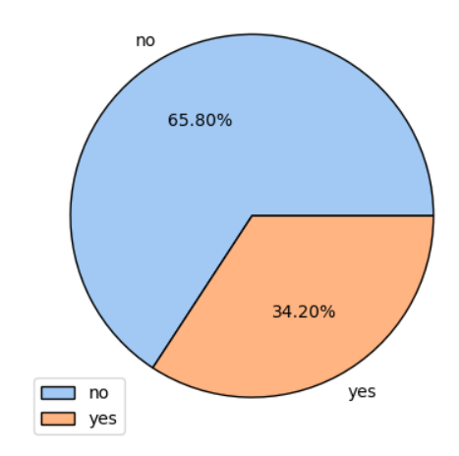
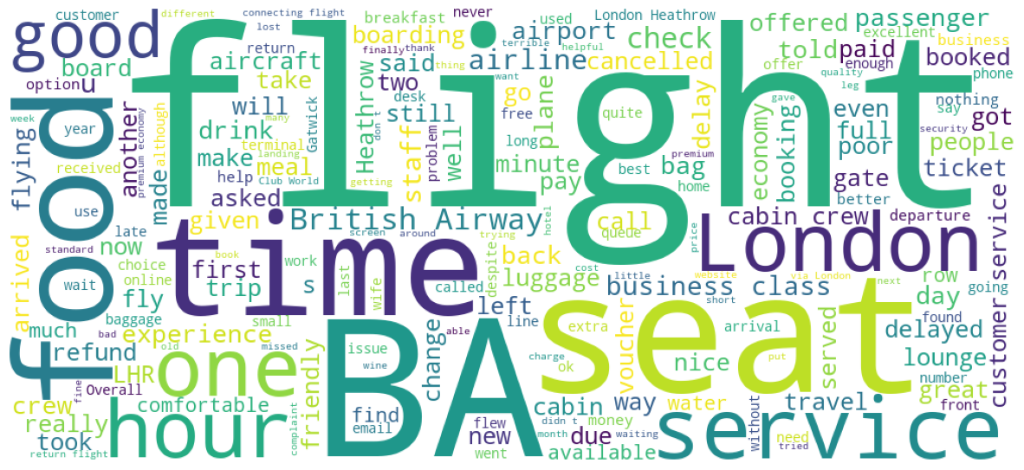
INSIGHTS FROM CUSTOMER REVIEWS
From cleaning 1000 reviews given by the customers, we obtained
Satisfied Reviews – 34.02%
Dissatisfied Reviews – 65.80%
Word cloud of keywords used in reviews

Slide 3
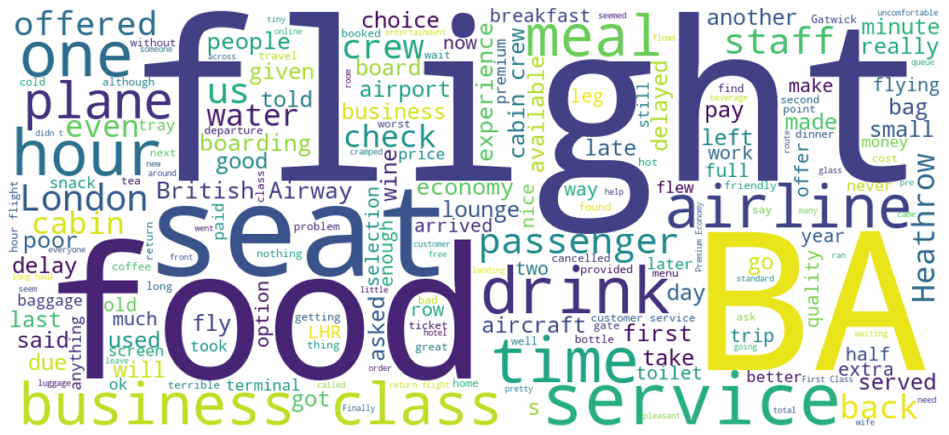
Analysis food on airways
I analyse the test.csv file, and get information that :
Time to deliver the order is too long
For free catering just bottle of water and a packet of crisps
Minimal selection of food items for purchase.

Slide 4
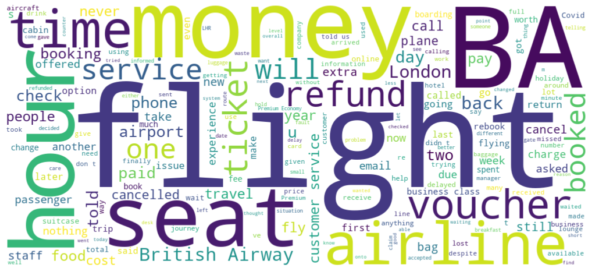
Analysis value for money
What I get from analysis the data :
1.The refund take a lot of time
2.Forced to use of vouchers however it was useless
3.Long delay time

